Slide 1
Ethical Reasoning in Practice
Ethical Theories
Use Ethical Decision-Making Frameworks
Select Options for Action
Avoid Problems in Ethical Decision-Making

Slide 2
Ethical Theories
Topic A

Slide 3
What Is Ethical Decision-Making?
Ethical decision-making: The process of identifying ethical risks, developing options for action, and selecting an option that is supported by the best available reasons.

Slide 4



Overview of Ethical Theories
Ethical theories: Systematic efforts to understand moral concepts and justify moral principles.
Virtue Ethics
Deontology
Consequentialism
How can we lead a virtuous life?
What are our moral duties?
How can we bring about the best consequences?

Slide 5
Virtue Ethics
Virtue ethics: An ethical theory that that emphasizes virtues of mind, character, and sense of honesty.
Virtue examples: Wisdom, justice, beneficence, temperance, courage, and honesty.
Virtue-based approaches assume that ethics is about leading a virtuous life.
To lead a virtuous life, we need to cultivate the virtues—excellences of character that promote human flourishing.
Virtue ethics can help identify the right thing to do by focusing on what a virtuous person would do in a given situation.
Famous Proponents
Aristotle, Confucius

Slide 6
Deontology
Deontology: An ethical theory that states the right thing to do depends on complying with the right kinds of rules and principles, no matter the outcome of one’s actions.
Deontology approaches prioritize acting in accordance with moral duties.
One key principle is that we must never treat other people as means, but always as ends in themselves.
Famous Proponents
Kant

Slide 7
Consequentialism
Consequentialism: An ethical theory that maintains that the rightness or wrongness of actions depends exclusively on the goodness or badness of consequences they bring about.
Example: Classic utilitarianism
The best-known utilitarian slogan is “the greatest happiness for the greatest number.”
Versions of consequentialism differ on:
What should be promoted (happiness, well-being, or certain human capabilities).
Whether our focus should be on consequences of individual acts or the rules that we follow.
Famous Proponents
John Stuart Mill

Slide 8
Triangulation Between Ethical Theories
Each theory has strengths and weaknesses.
Different moral theories sometimes seem to pull us in different directions.
There is no simple formula for resolving these cases, but we can seek to identify courses of actions supported from the perspective of several ethical theories.
Virtue Ethics
Deontology
Consequentialism

Slide 9
Guidelines for Using Ethical Theories in Decision-Making
Guiding questions based on the three approaches:
Virtue Ethics
Would we want future technologists to repeat ​our​ actions?
What will this product say ​about us as people?
How might this product change character habits of users and other stakeholders?
Do our choices strike the appropriate mean​ between deficit and excess, and do we appropriately balance all the virtues?
What ​rights​ of and duties​ to others must we respect?
Can our choice be ​universalized?
Are we following a rule that could be generalized?
How might stakeholders’ dignity​ and autonomy​ be affected?
Does our product treat people in ways that are ​transparent?
Deontology
Consequentialism
What benefits and burdens are created by this project, and how are they distributed among stakeholders?
Will the effects likely create more overall good than harm?
How might future generations be affected by this product?
Are there missed opportunities to generate even greater benefits?

Slide 10
Activity: Applying Ethical Theories in Decision-Making
Scenario: RudiBrace team.
What is one ethical concern that consequentialist reasoning might raise about RudiBrace?
What is one ethical concern that deontological reasoning might raise about RudiBrace?
What is one ethical concern that virtue ethics might raise about RudiBrace?

Slide 11
Use Ethical Decision-Making Frameworks
Topic B

Slide 12
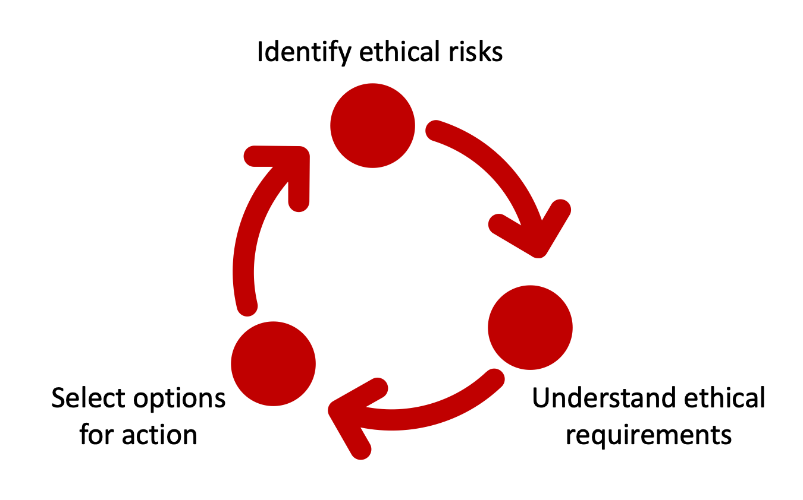
Phases of Ethical Decision-Making
Identify ethical risks
Understand ethical requirements
Select options for action

Slide 13
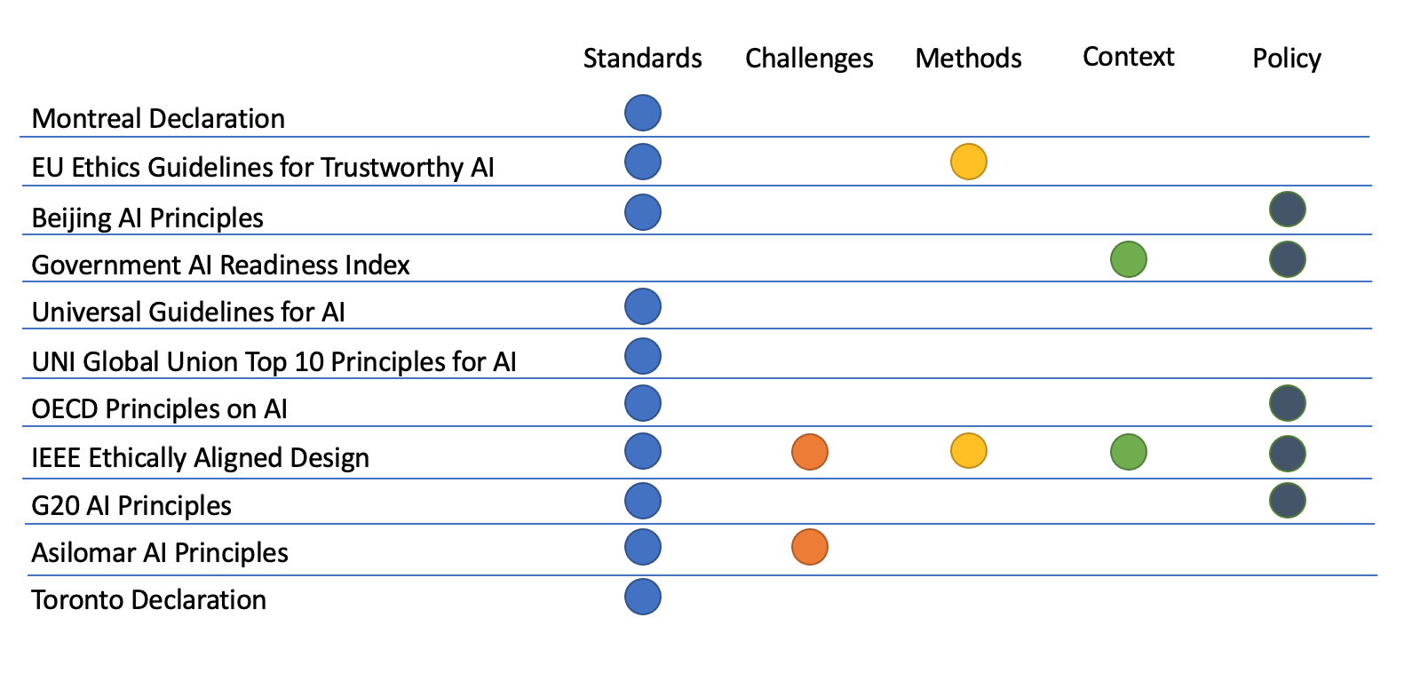
Ethical Decision-Making Frameworks

Slide 14
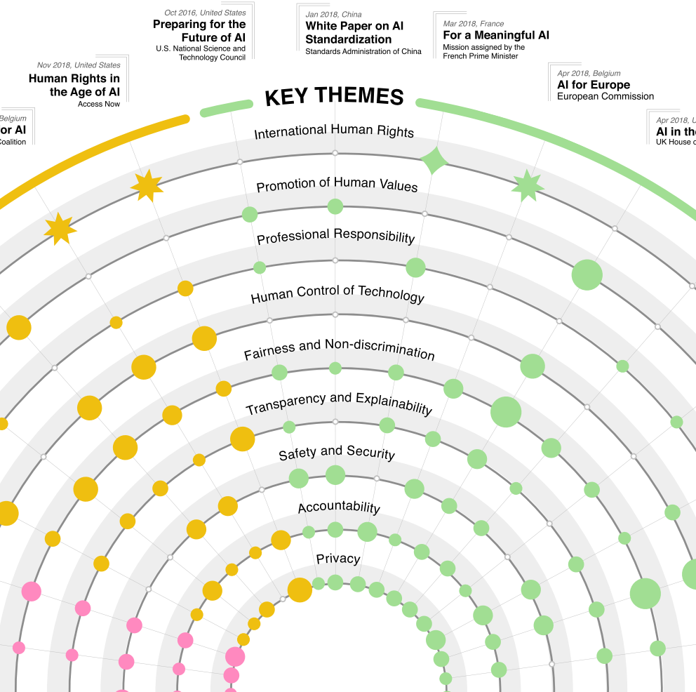
Key Ethical Considerations

Slide 15
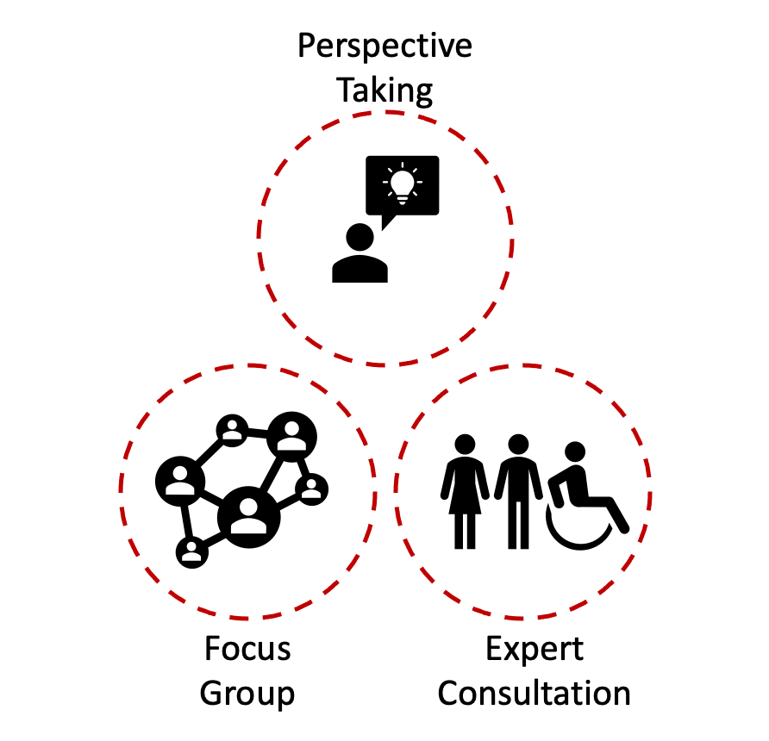
Stakeholder Engagement Strategies
Perspective taking
Focus group
Expert consultation

Slide 16






Challenges to Ethical Decision-Making
Complexity
Disagreement
Some ethical risks are too serious or complex for organizations to resolve alone.
Persistent disagreement about how to resolve certain ethical tradeoffs.
Ethics is not a box-ticking exercise, but a process requiring skill, reflection, and sometimes coordination with other actors.

Slide 17
Activity: Identifying the Best Framework for a Situation
Scenario: General discussion.
Decide which framework for ethical decision-making would be best to consult in the following situations:
You want to introduce a company-wide method for ethical decision-making.
You want to apply local guidelines for ethical decision-making in a subsidiary company in China.
You want to expand your business to several African countries, but you are unsure about the level of regulation for ethical decision-making in local contexts.
You want to send your colleagues a document that comprehensively covers information about ethical decision-making.

Slide 18
Select Options for Action
Topic C

Slide 19
Completing the Ethical Decision-Making Cycle
Identify ethical risks
Understand ethical requirements
Select options for action

Slide 20
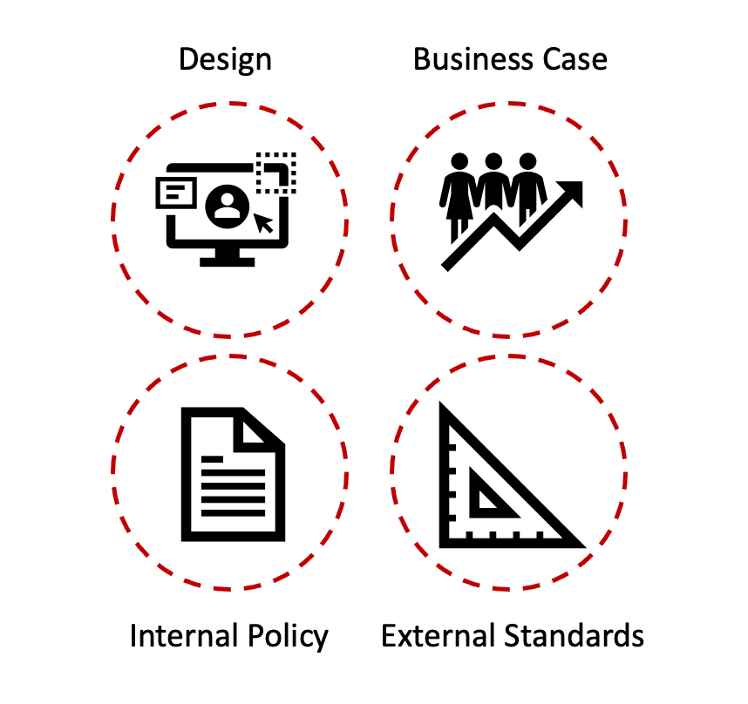
Strategies to Resolve Ethical Risks
Design
Business case
Internal policy
External standards

Slide 21
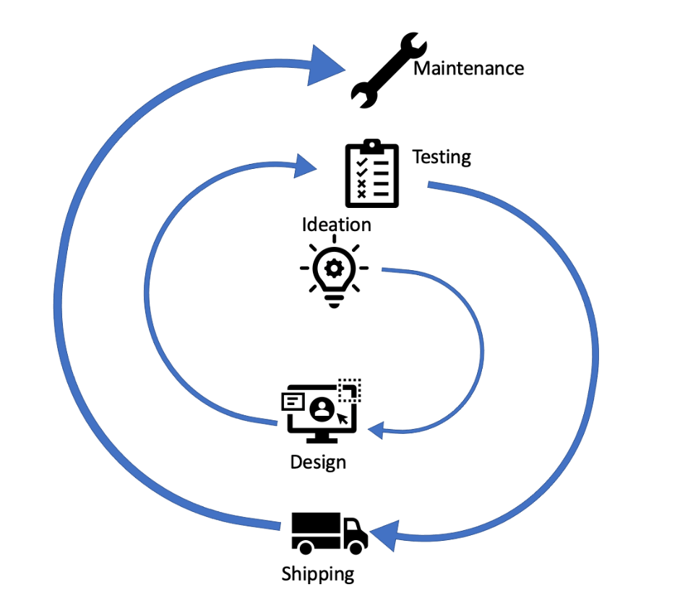
Addressing Ethical Risks in Product Development
Impact Assessment
Ethics by Design
Includes Value-Sensitive Design

Slide 22
Ethics by Design
Ethics by design: An organizational approach to product development that focuses on addressing ethical risks early on, between the ideation and design phases of the product development lifecycle.
Ethical aims
What problems should we try to solve?
What values should we try to promote?
Design ideas
What viable products could we create to achieve our ethical aims?
What are the tradeoffs involved?
Design requirements
List technical requirements for privacy settings, etc.
Setting ethical aims
Setting design requirements
Consider design ideas

Slide 23
Value-Sensitive Design
Value-sensitive design: An implementation of ethics by design (often used in technology design) that accounts for human values in an ethical and systematic manner.
Values
Norms
Design Requirements
Privacy
Fairness
Non-discrimination
Users should give informed consent.
Third parties should not access user data.
User-friendly control panel for data use
Encryption of user data

Slide 24
Impact Assessment
Impact assessment: A technology design approach that focuses on assessing different options for action to resolve ethical risks.
Tradeoff: Balance achieved between multiple desirable outcomes that are not mutually compatible.
Types of ethical tradeoffs:
There is only one value at stake, but impacts are different for different stakeholders.
An ethical risk affects only one stakeholder group, but different values are at stake.
An ethical risk affects different stakeholders, and multiple values are at stake.

Slide 25





Common Strategies for Making Tradeoffs
Methods of distributive justice.
Cost-benefit reasoning.
The Delphi Method for stakeholder engagement.
Group A interests:
Privacy
Fairness
Group B interests:
Reuse of data
Cost containment
Distributive justice
Cost-Benefit
Delphi Method

Slide 26
Difficulties in Making Tradeoffs
Making tradeoffs involves analyzing and comparing the strength of competing interests of different stakeholders.
Tough cases may call for the assistance of experts in applied ethics.
Applied ethicists are trained in advanced methods for identifying and resolving conflicts of interest.
Sometimes, you can’t resolve the conflict.
Especially when tradeoffs must be made between different values for the same group of people (privacy vs. security).
Stakeholder engagement can help.

Slide 27
Distributive Justice
Distributive justice: The practice of resolving conflicting interests.
Common method for applying distributive justice:
Imagine a situation where a particular course of action is chosen.
Imagine, furthermore, that you don’t know your own position in society.
You might be a stakeholder that is affected by the decision.
Out of the variety of possible actions, consider which action would yield the maximum benefit for the individual or group that is most affected by it. This action would be preferred.

Slide 28
Cost-Benefit Reasoning
Cost-benefit reasoning: A form of deduction that applies the principle that a decision or action should provide a greater benefit than the cost required to implement the decision or action.
Analyze competing interests according to costs and benefits.
Compare the results of the analysis.
Tradeoffs involved can’t always be reduced to money.
Affected parties may have differing characteristics.
You still might be able to narrow down the options.
Break down complex scenarios into simpler comparisons.

Slide 29
The Delphi Method for Stakeholder Engagement
Panel Evaluations
Definition of items, interaction structure, evaluation scales, etc.
Round 1
Monitoring and feedback
Panel Evaluations
Round n
Report

Slide 30
Activity: Selecting Strategies to Resolve Ethical Risks
Scenario: RudiBrace product. The team has identified the following risks:
Security risk of data breach and leaking of personal data
Privacy risk from misuse of personal data
Transparency risk of having insufficient insight into collected data
Efficiency risk from lower social engagement due to lack of data collected
Can you suggest an action for one of the ethical risks the team identified for RudiBrace?
Can you suggest a possible tradeoff for the action you identified?
Can you suggest a strategy for resolving the tradeoff?
Investigate human-rights issues that are relevant to your industry.

Slide 31
Avoid Problems in Ethical Decision-Making
Topic D

Slide 32




Biases and Prejudices
Bias: Prejudice in favor of or against a person, group, or thing as compared with another, usually in an unfair way.
Biases and prejudices can undermine the ethical decision-making process.
It’s easier to believe things fit in our worldview, even if they don’t.
Biases come in many forms.
Biases skew our view of how important something is, and what role it should play in our moral reasoning.

Slide 33

Groupthink
Groupthink: A form of bias that occurs when group members fail to voice opposing views.
Ways to avoid groupthink:
Assign at least one group member the role of devil's advocate, rotating at each meeting.
Discourage leaders from expressing an opinion early in the discussion, and even encourage them to absent themselves from group meetings to avoid excessively influencing the outcome.
Set up several independent groups to work on the same problem.
Invite outside experts into meetings.

Slide 34








Establishment of a Legitimate Decision-Making Process
Who has input?
Who makes the decision?
Checks and balances

Slide 35

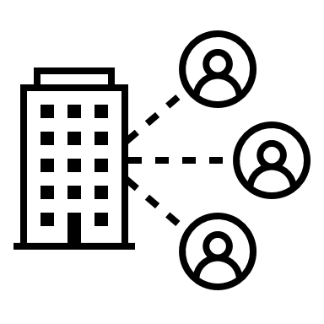




Strategies for Legitimate Decision-Making
Include all affected parties in decision-making
Consult experts
Defer questions to government bodies
Consider stakeholder interests

Slide 36










Paternalism and Technocracy
Paternalism: The phenomenon that decisions about one’s own interests, for one’s ‘own good’, are made by someone else.
Technocracy: Rule by experts.
Democracy: Rule by the many.
“I know what’s best for you.”
By including affected parties, you can protect against these risks.

Slide 37



Ethics Washing
Ethics washing: Engaging in ethical reasoning without being motivated to do the right thing.
How to avoid ethics washing: share/give up decision-making power about ethical issues
Look, we do ethics!
(But… only for show.)

Slide 38
Activity: Establishing an Ethical Decision-Making Process
Scenario: Genetic testing for consumers.
Direct-to-consumer genetic testing based on a saliva sample.
Genetic data is analyzed to generate reports relating to the customer's ancestry and genetic predispositions to health-related topics.
In addition, the databases of genetic information are used to conduct medical research.
The model has the potential to promote good outcomes, such as discovering new drugs. Yet it also raises serious ethical issues about user privacy and data protection.
Which people or groups should be involved in setting company policy about these questions?
What are some ways that these companies could share or give up power to improve the legitimacy of these decisions?

Slide 39
At your workplace, which phase of ethical decision-making do you think will be the most challenging to implement?
Do you feel that any of the ethical pitfalls discussed are prevalent in your workplace? If so, which ones, and why?

